Slide 1
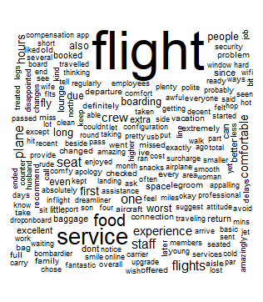
IST687 Airline Project
Xiwei Shen, Nikita Dongare, Tejas Patil
Aditya Sai, Surjit Singh, Justin Lim

Slide 2
Agenda
Introduction
Business Questions
Problem Analysis
Interpretation of the Results
Measures to reduce attrition

Slide 3
Introduction
Goal: Identify leading indicators to reduce customer attrition ahead
Southeast Airlines want to lower customer attrition
Implemented loyalty program, but customer valued loyalty program less
Current airline data
Independent variable: likelihood to recommend (1-10)
Dependent variable: any other attributes which has impact on independent variable

Slide 4
Data
Traveler Attributes
Age, Gender, Price Sensitivity, Spending habits, Loyalty Accounts
Travel Attributes
Class, Date, Destination, Airline Status, Departure Hour
Experience Attributes
Delay in Arrival and Departure, Flight time, Distance

Slide 5
Business Questions
Is the current reward system efficient?
What are effects of age and gender on satisfaction?
Does travel origin and destination affect satisfaction?
Does dates of travel and day of month affect satisfaction?
Does type of travel, airline status and class of travel affect satisfaction?
How is satisfaction affected by delays and length of travel?
Do the Spending habits at the airport affect satisfaction?
What factors predict NPS?

Slide 6
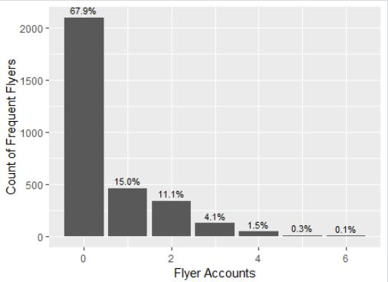
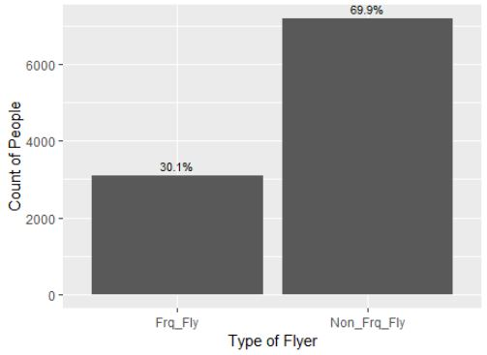
Is the current reward system efficient?

Slide 7
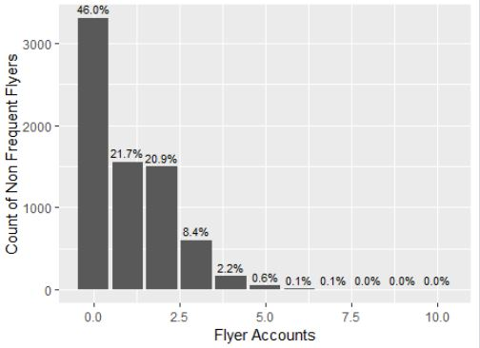
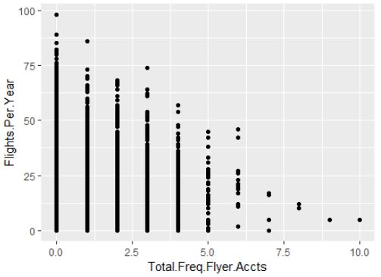
Is the current reward system efficient?

Slide 8
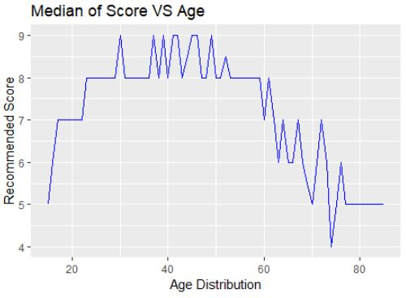
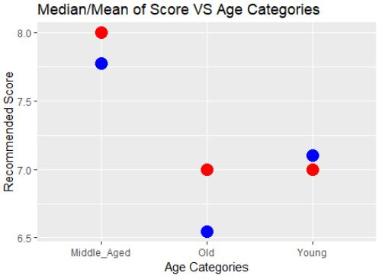
What are effects of age and gender on satisfaction?

Slide 9
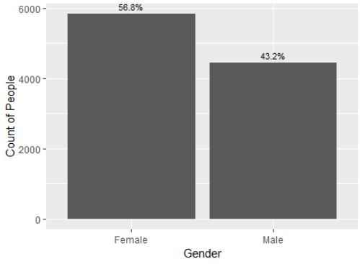
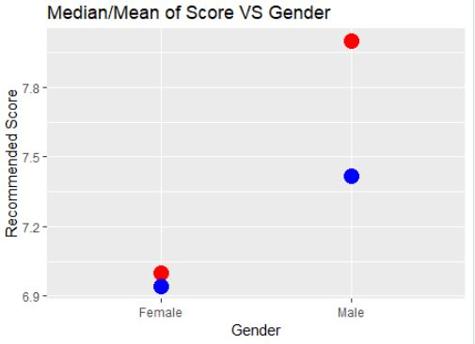
What are effects of age and gender on satisfaction?

Slide 10
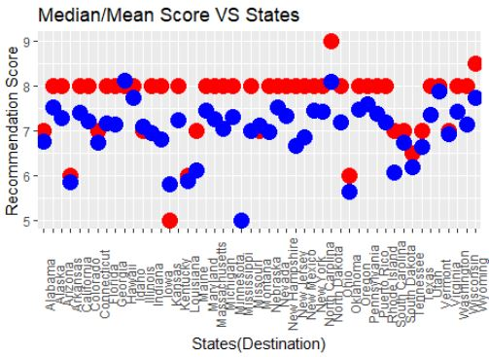
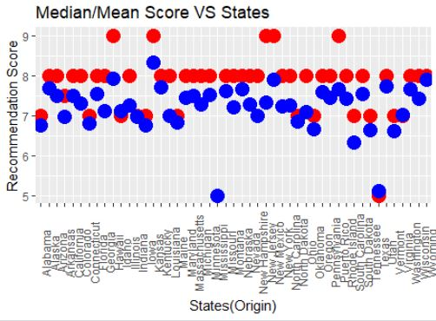
Does travel origin and destination affect satisfaction?

Slide 11
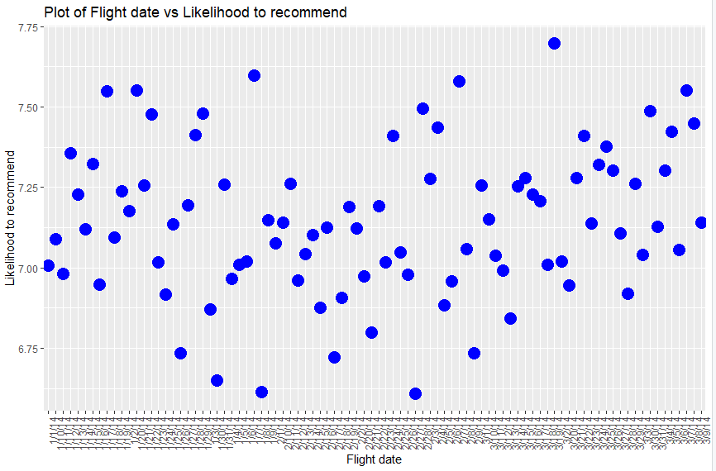
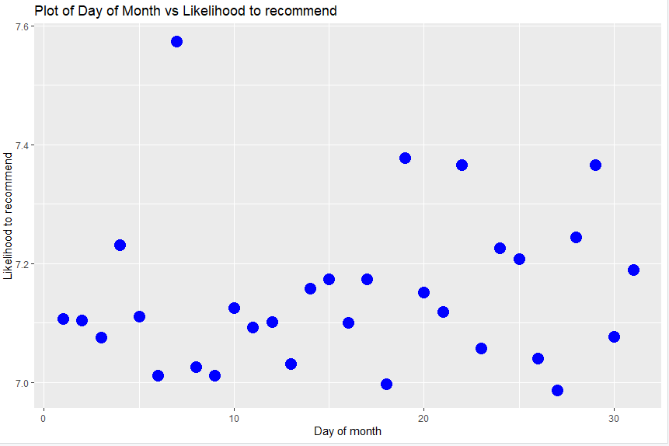
Does dates of travel and day of month affect satisfaction?

Slide 12
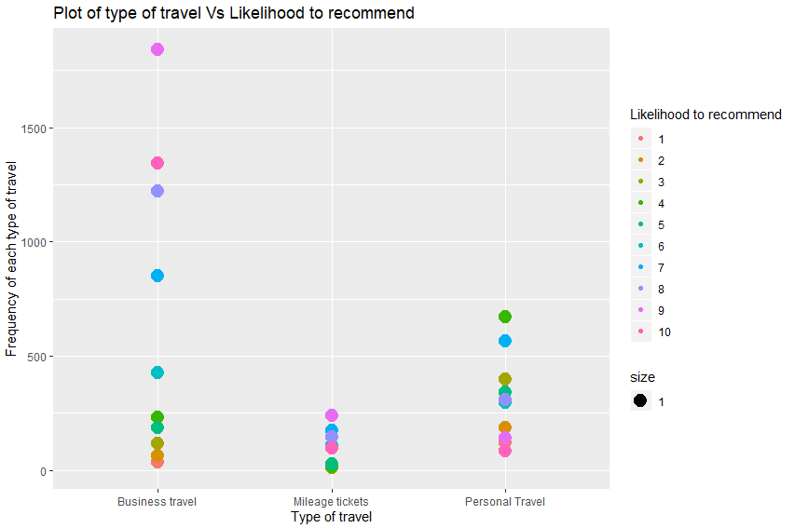
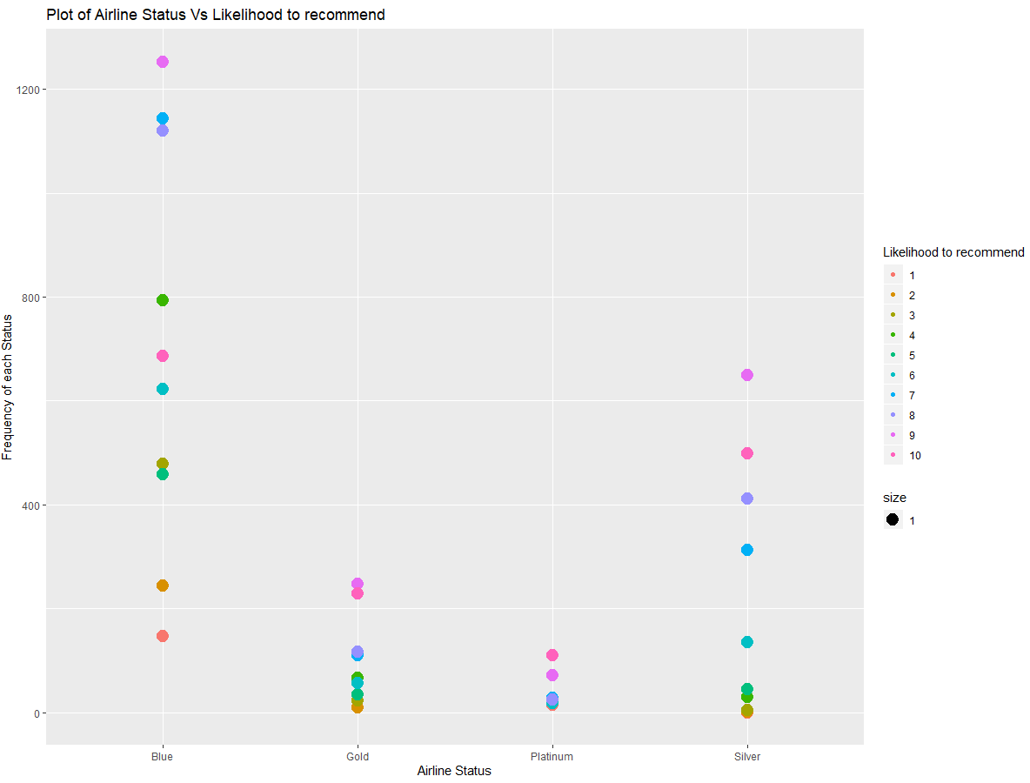
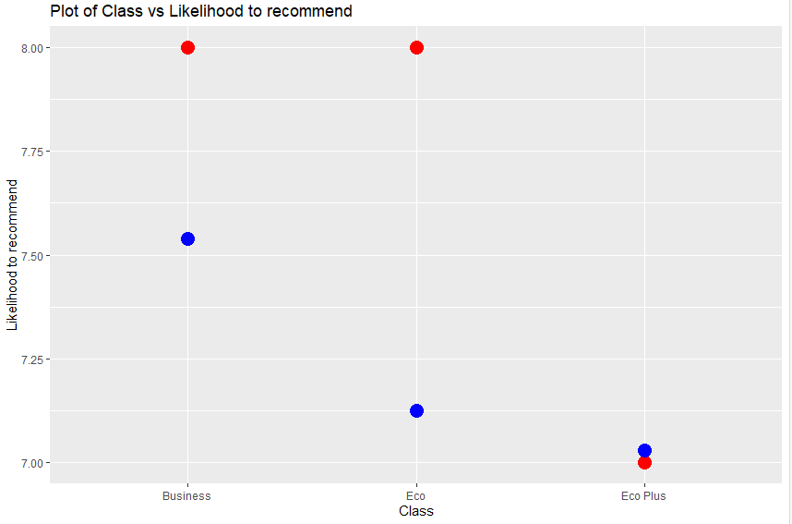
Does type of travel, airline status and class of travel affect satisfaction?

Slide 13
Does type of travel, airline status and class of travel affect satisfaction?

Slide 14
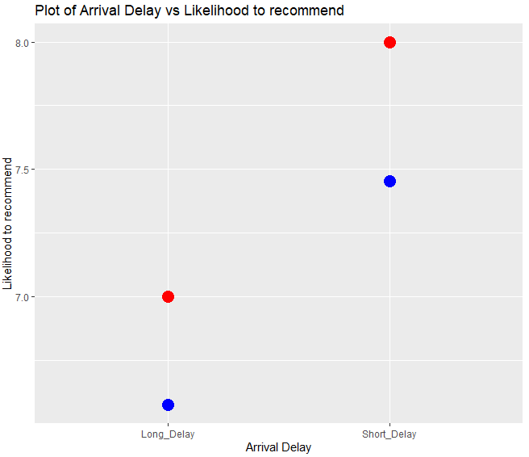
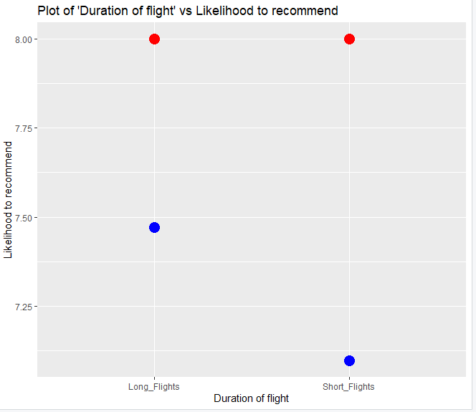
How is satisfaction affected by delays and length of travel?

Slide 15
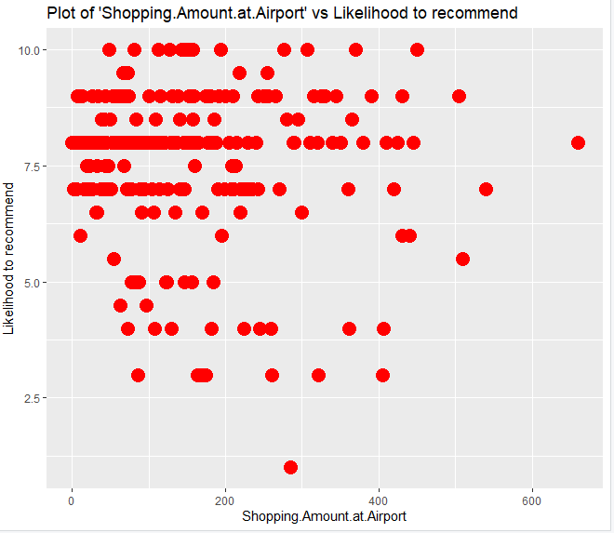
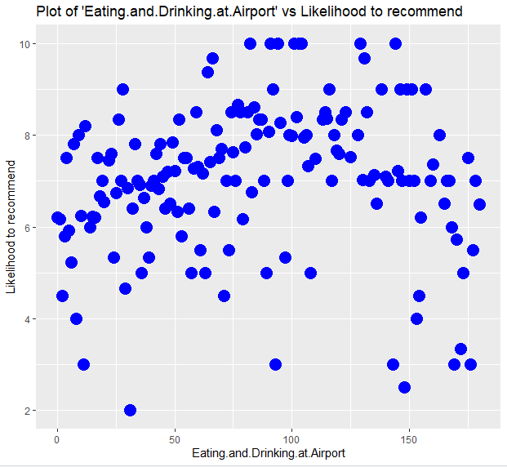
Do the Spending habits at the airport affect satisfaction?

Slide 16
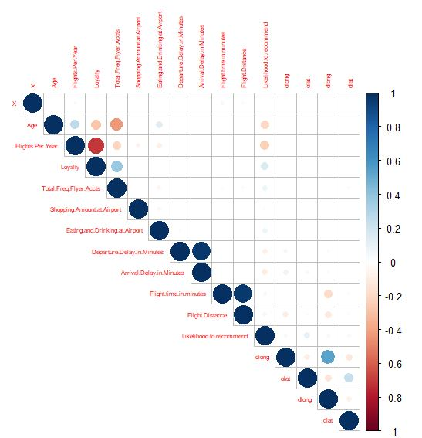
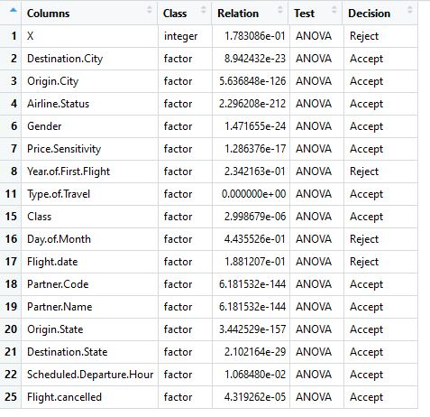
What factors predict NPS?

Slide 17
Models
Multi-Variables Linear Regression
Prediction Power : 47.95%
Accuracy : 77.6%
Apriori Algorithm
Support Vector Machine
Accuracy : 80.2%

Slide 18
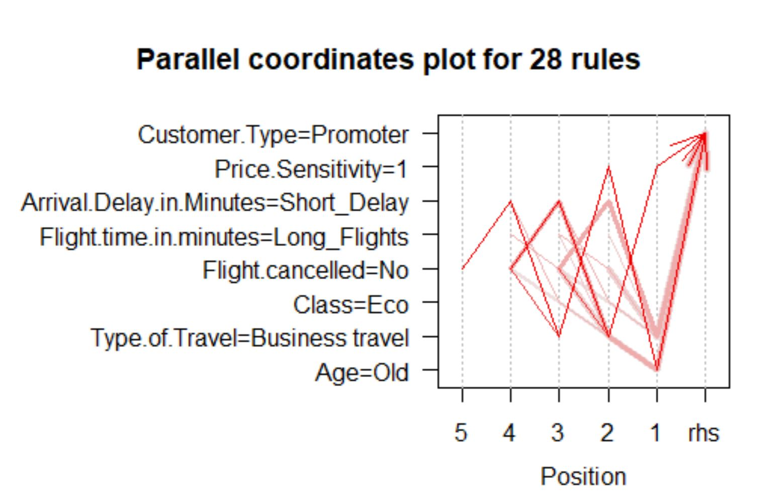
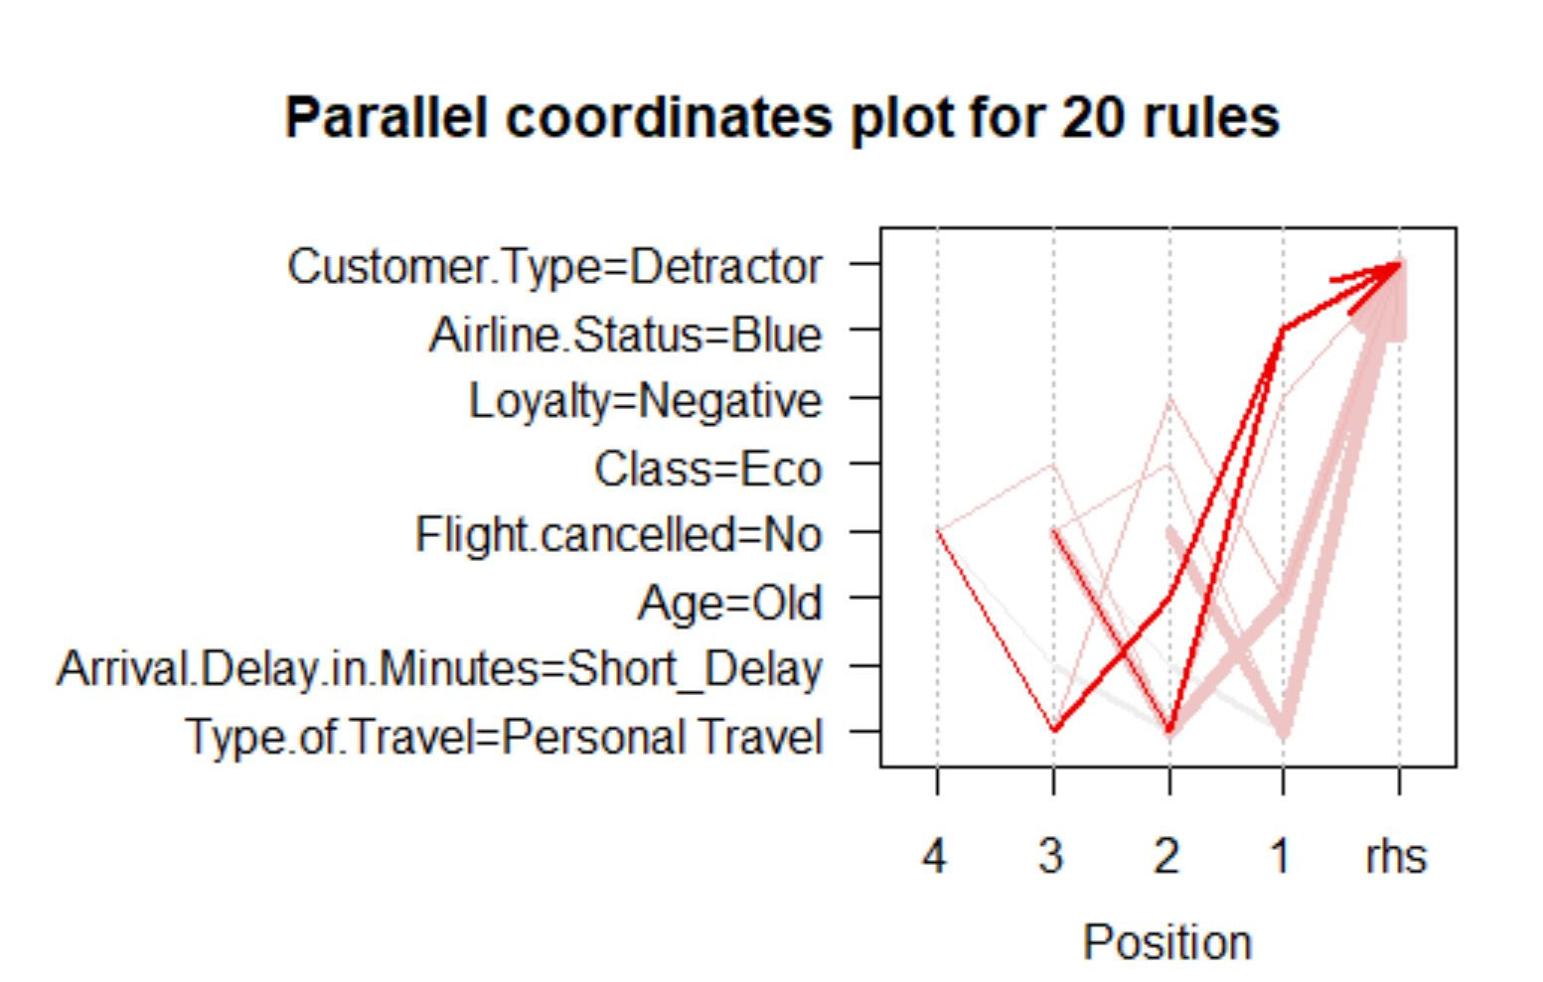
Causes for Promotion/Detraction

Slide 19
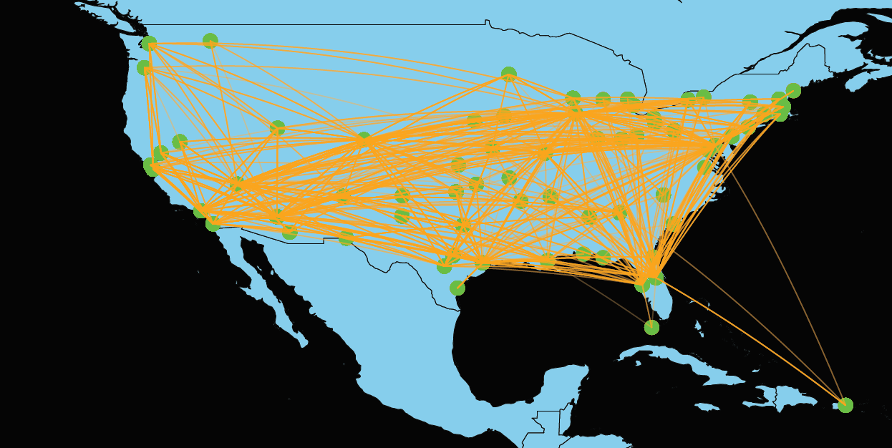
Partner Airline Routes - Cheapseat

Slide 20
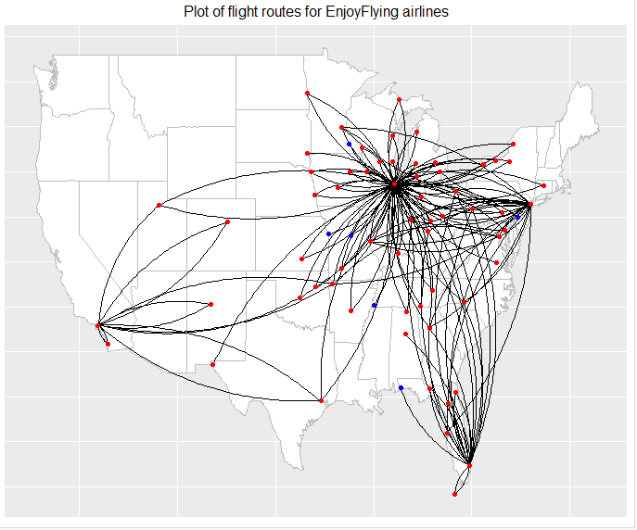
Partner Airline Routes - EnjoyFlying

Slide 21
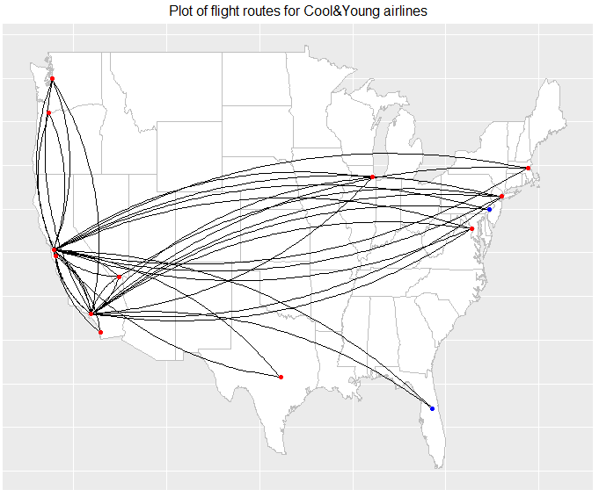
Partner Airline Routes - CoolYoung

Slide 22
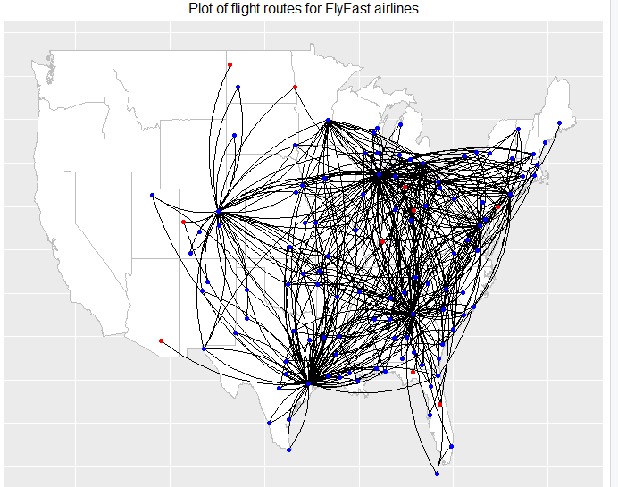
Partner Airline Routes - FlyFast

Slide 23
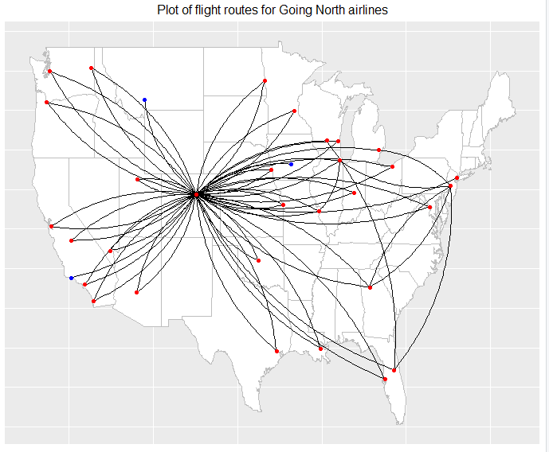
Partner Airline Routes - Going North

Slide 24
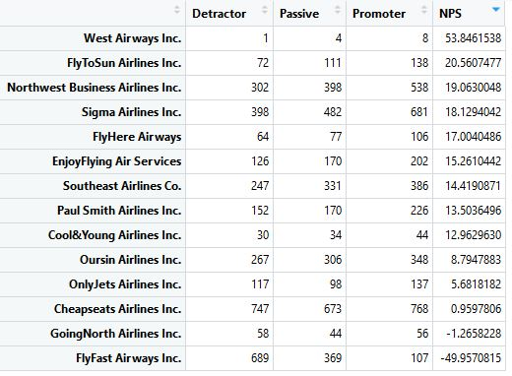
NPS Scores

Slide 25
Suggestions for Southeast airlines
Flyfast, GoingNorth is important partner but contract renewal only for shorter duration
CoolYoung, EnjoyFlying is important partner with good NPS and longer term contract extensions
Airports which are significant predictors need to increase operations efficiency
Personal Travel and Airline status Blue travelers need to be given more incentives to increase attrition.

Slide 26
Thank You!

